Slide 1
ICT TOOLS & SYSTEMS

Slide 2
Let`s get to know each other

Slide 3
Class Rules
Attendance and conduct:
1.Please, be on time and do not leave early without any reason.
2.If for some exceptional reason you must come late or leave early on a particular day (not days),please alert me in advance.
3.No first names of professors are used when addressing directly -Mr./Ms., Professor, Ma’am/Sir only.
4.Missing more than 25% of the classes during one semester leads to the failure of the course.

Slide 4
Syllabus
ICT_Syllabus
Already uploaded to Moodle

Slide 5
Moodle

Slide 6
How to access?

Slide 7
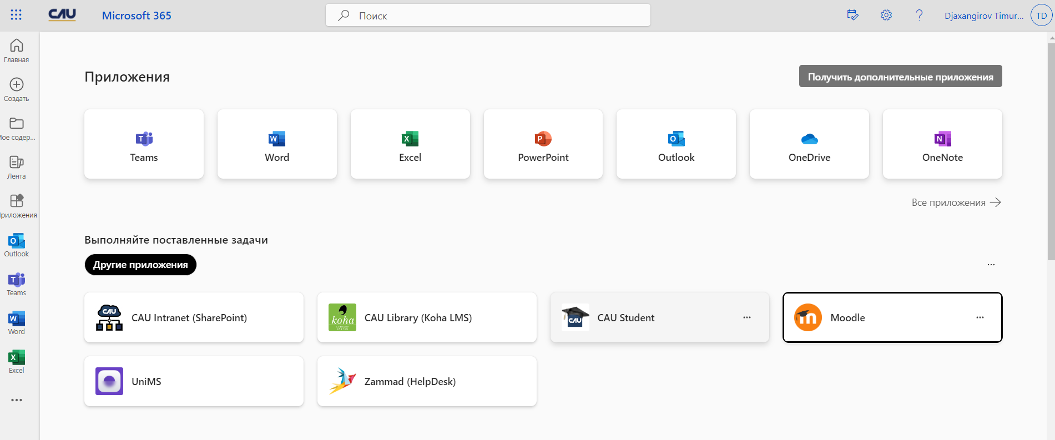

Slide 8
How to log in

Slide 9
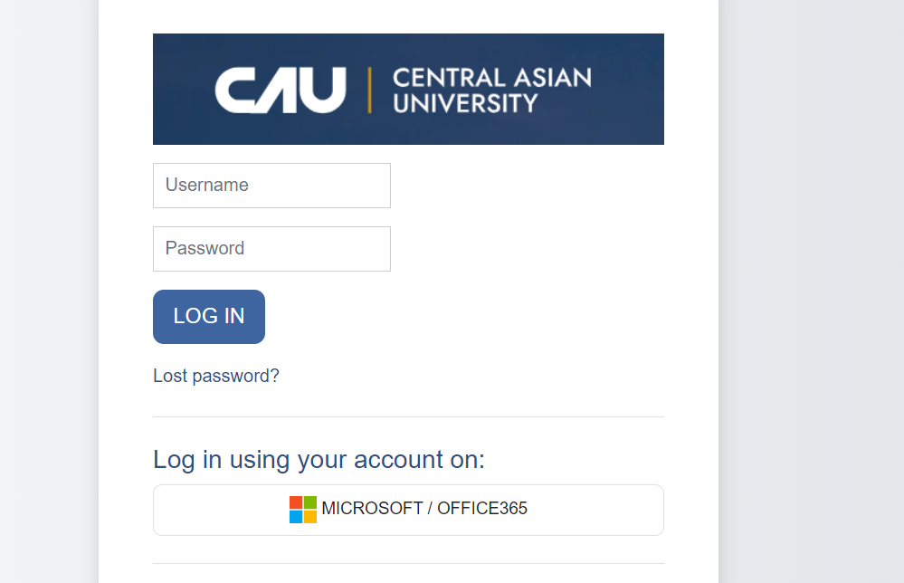
It is possible to log in both manually by providing name and password and via the microsoft 365 account (must be log in before that)

Slide 10
Functionality in moodle
Moodle can function as a news portal, dashboard and a repository with all the study materials student needs.
Moreover, moodle has a number of features for communication

Slide 11
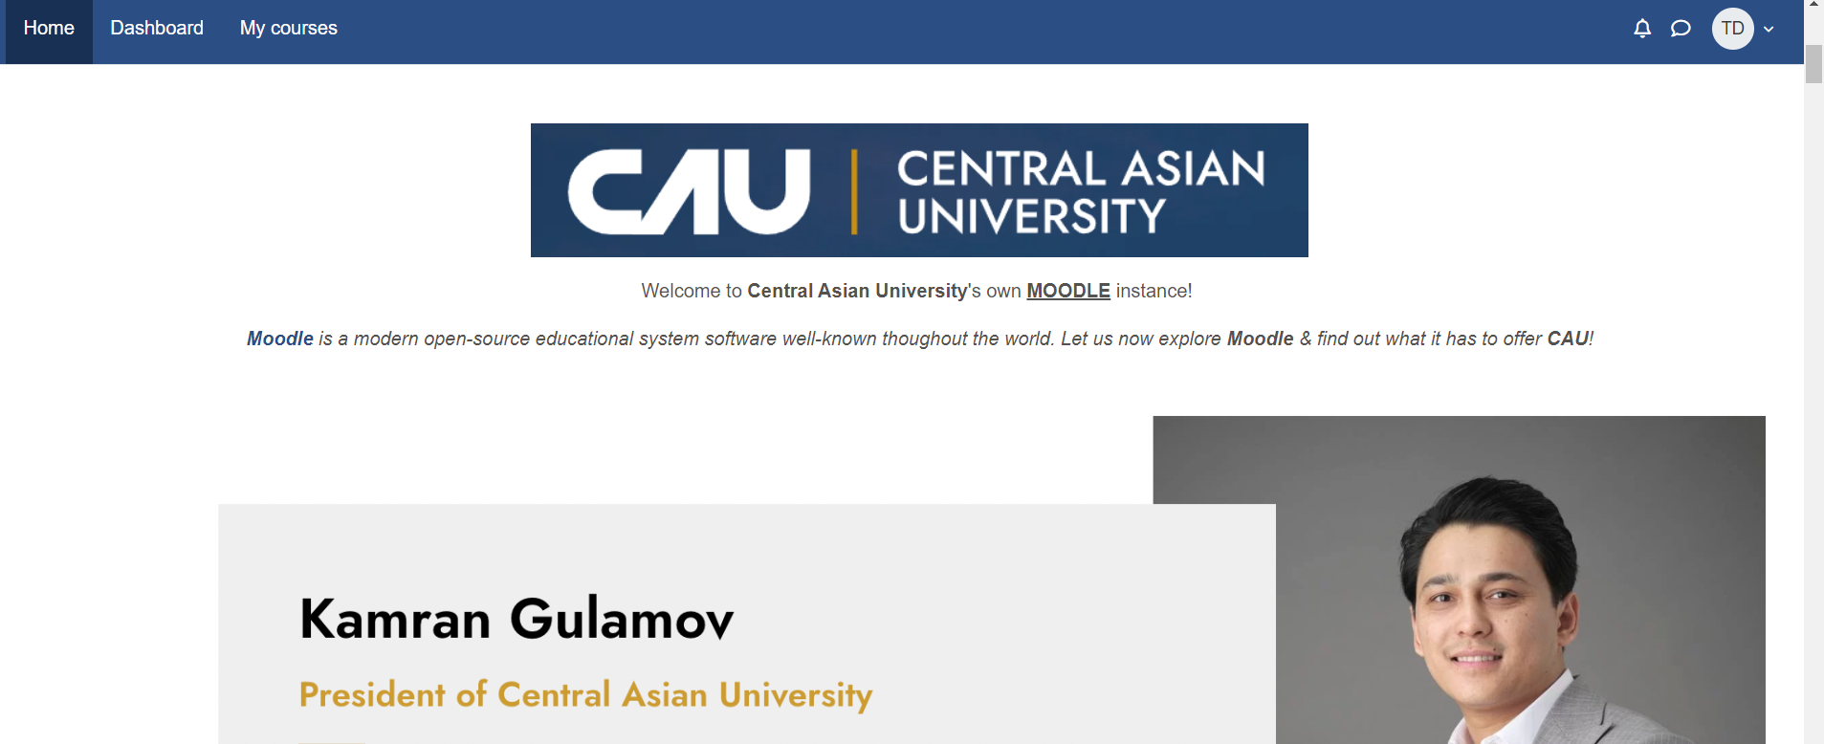
News portal
By default, moodle will open on the "home" tab.
Here one can see latest news added by the university team as well as premade information for reference.
Moreover, on this main page one can find a list of all the available courses with categories for quick navigation.

Slide 12
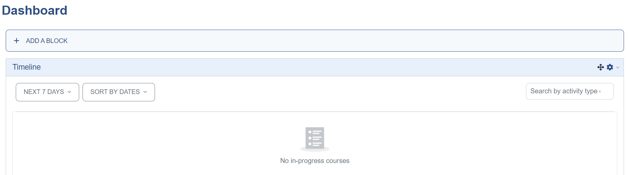
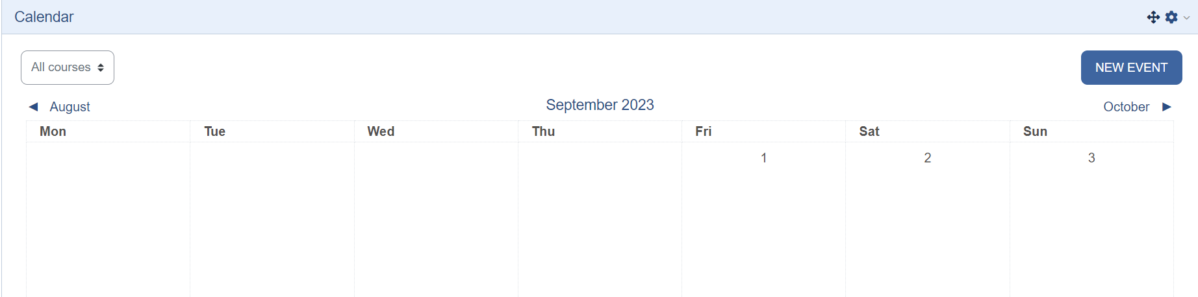
Dashboard
Is the space where one can find timetable, deadlines and academic calendar with all the necessary information.
One can track assigments and events conviniently from this tab.

Slide 13
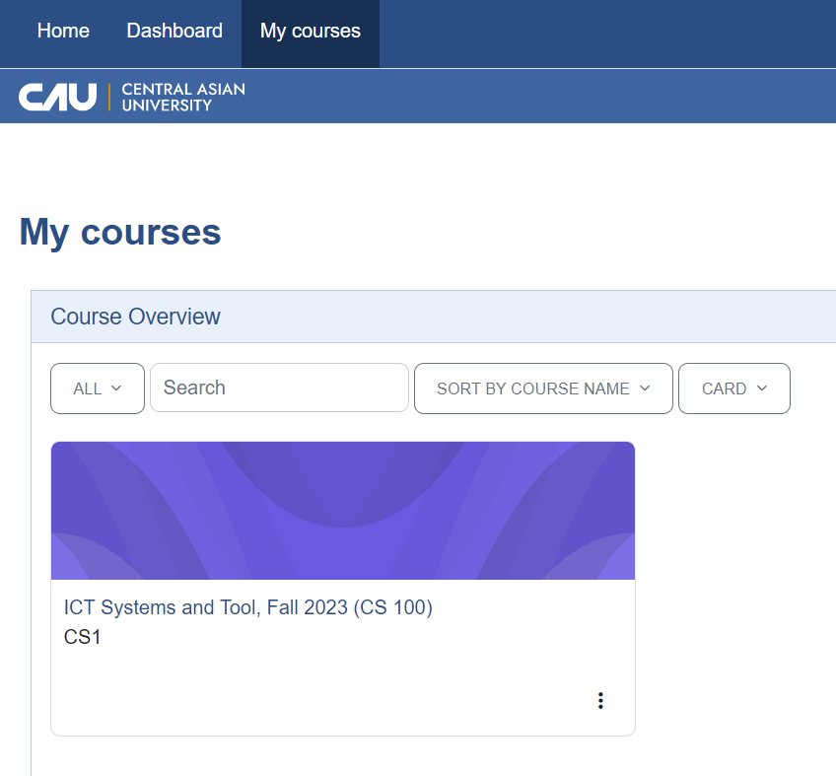
Repository
In "my courses" tab one can access all the study materials listed in order, check and submit assigments and communicate with class and instructor.

Slide 14
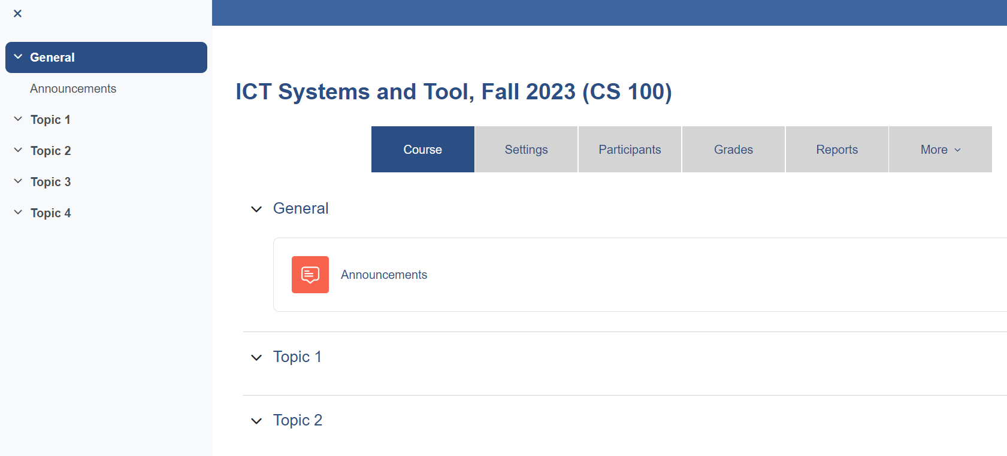
Courses
By clicking on a course, one can access all the uploaded contents separated by topics (usually in a weekly fashion), as well as announcements made by teacher (such as change in a timetable, updates on some information, etc.)

